Slide 1

Sentiment Analyzer (Twitter)
November 2014
IIIT Hyderabad
Manpreet Singh
Pinak Chakraborty

Slide 2
Background
Twitter is a popular microblogging service where users create status messages (called “tweets”).
These tweets sometimes express opinions about diﬀerent topics.
We propose methods to automatically extract sentiment (positive or negative) from a tweet.
This is very useful because it allows feedback to be aggregated without manual intervention:
Organizations can use this to gather critical feedback in newly released products.
Marketers can use this to research public opinion of their company and products, or to analyse customer satisfaction.
Consumers can also use sentiment analysis to research products or services before making a purchase.

Slide 3
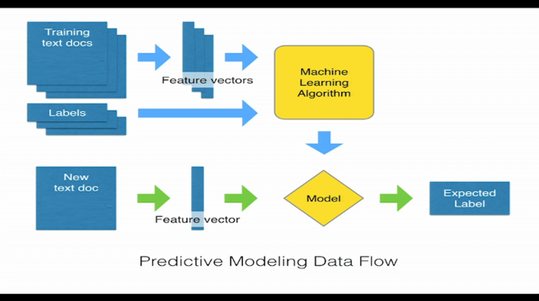
Problem Formulation
This is a classification problem which we attempt to resolve using supervised machine learning algorithms.
We will describe the steps mentioned in the flow diagram below in the rest of this presentation:
Feature Extraction
Dataset (Training)
Classifier
Calculated Parameter
Dataset
(Test/live)
Outcome

Slide 4
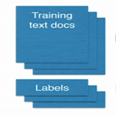
Dataset
In order to train a classiﬁer, supervised learning requires labelled data for training.
With the large range of topics discussed on Twitter, it would be very diﬃcult to manually collect enough data to train a sentiment classiﬁer for tweets.
Our solution is to use distant supervision, in which our training data consists of tweets with emoticons.
With the help of the Twitter API, it is easy to extract large amounts of tweets with emoticons in them.
We run classiﬁers trained on emoticon data against a test set of tweets (which may or may not have emoticons in them).

Slide 5
Data insight
Twitter messages have many unique attributes as follows:
Length: The maximum length of a Twitter message is 140 characters. From our training set, we calculate that the average length of a tweet is 14 words or 78 characters.
Data availability: With the Twitter API, it is very easy to collect millions of tweets for training.
Language model: Twitter users post messages from many diﬀerent media, including their cell phones. The frequency of misspellings and slang in tweets is much higher than in other domains.
Characteristics of this data set
Sparse document – term matrix accentuated by the unique words in tweets resulting from misspelling, slung, use of different languages used in the tweets.
Noisy level of training data as the training process makes use of emoticons as class levels

Slide 6
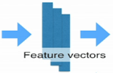
Feature Engineering
Sentiment Tokens - which words are relevant for sentiment analysis?
URLs, Hashtags, numbers, dates?
All words?
We parsed the tweets after stripping of the URLs, Hashtags, emotions and used:
Adjectives, Verbs, Nouns and Adverbs as our feature set of sentiment analysis
This removed all stop words, like, determinants (A, An, The), Conjunctions (And, Or) from feature set that are not meaningful for sentiment analysis.
We use NLP POS Tagging algorithms to POS tag the words used for extraction
This extraction process reduced dimension of feature vector but preserved the necessary sentiment information

Slide 7
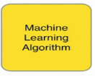

Solution Approaches
We used three diﬀerent classiﬁers: A Naïve keyword-based, Multinomial Naive Bayesian, and support vector machines.
A Naïve keyword-based classifier : Twittratr(http://twitrratr.com/) is a website that publishes a list of positive and negative keywords. For each tweet, we determine goodness and badness of the tweet . This classiﬁer returns the polarity with the higher count.
Multinomial Naive Bayes classifier : In multinomial Naïve Bayesian classified a tweet (d) is assigned to class c*, where:
Binarized (Boolean feature) Multinomial Naive Bayes classifier
For sentiment analysis, word occurrence may matter most than word frequency.
This leads us to Binarized (Boolean feature) Multinomial Naive Bayes classifier where we clip all the word counts in each document (tweet) at 1.

Slide 8
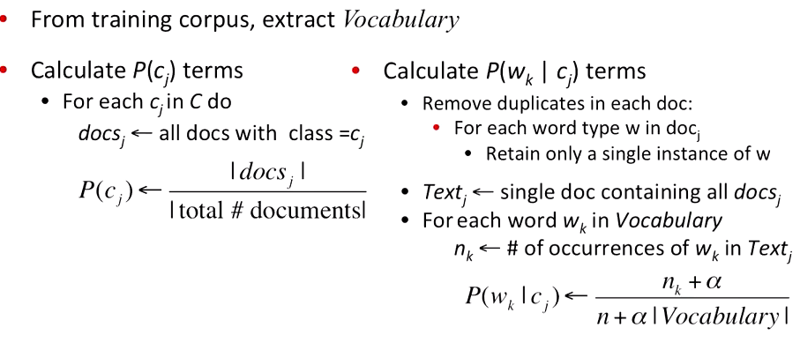

Solution Approaches (cont’d)
Binarized (Boolean feature) Multinomial Naive Bayes classifier - Learning
Binarized (Boolean feature) Multinomial Naive Bayes classifier – Analysing
First remove all duplicate words from document (tweet) d. Then compute Naïve Bayes using the same equation:

Slide 9
Solution Approaches (cont’d)
Support Vector Machines : We use the SVM with a linear kernel.
Our input text is converted into numeric vector with each vector corresponds to the presence of a feature.
For example, with a unigram feature extractor, each feature is a single word found in a tweet. If the feature is present, the value is 1, but if the feature is absent, then the value is 0.
We use feature presence, as opposed to a count, which speeds up overall processing.

Slide 10
High Level Components
HDFS
Social Media
(Twitter)
Hosebird/Kafka
Storm
Split into Train and Test Datasets
Customer Interaction Hub
Hosebird/Kafka
Process the Train Dataset with Learning Algorithm
Model
Label, index, etc
Rework on improvements
Branch Interaction
Process the Test Dataset with Learning Algorithm
Call Centre
Chats/Emails
Happy with Classification %?
Assumptions:
Internal Customer Interaction data will be available for the project – otherwise only social media data will be used
This project will mainly develop the components highlighted in red
No
Plot Trends
Trends

Slide 11

Experiments
The machine learning algorithms clearly perform better than our Naïve keyword based classified used as baseline.
Baseline performance was around 75%.
Naïve Bayesian classifier returns around 82 % when run on unigram features.
SVM was around 83% when run on unigram features
We will try out the classifiers by taking bigrams and trigrams features.

Slide 12

Future Work
Extension of current solution:
A UI will be provided for testing of the sentences/tweets
Classifier: Improvements on classifier to solve problem of Noisy level
For tweets that are only marginally classified, manual input can be sought on their classification and ML Algorithm can learn from the manual input as reinforcement learning
Various ML algorithms, like Transductive SVM can be developed to treat partially labelled data in semi-supervised learning
NLP domain : The following specific challenges still remain to be resolved
Negation
Ordering of sentiments in a tweet/sentences
Mixed language in tweet (e.g. Hindi words used in an English sentence)
Semantics : Understanding of irony and sarcasm in the text that are easily understandable by human being but difficult learning problems

Slide 13
Future Work (cont’d)
Plan to use CLA (Nupic – Cortical Learning Algorithm)

